Slide 1

ATTENDANCE RECORDER

Slide 2

WHAT ?
This application is an application specifically built for students. As very clear from the name, this application helps the students to keep a track of their attendance.
It gives the student clear idea about how many lectures are available to bunk and what is the estimated attendance percentage at the end of the semester.
SO, LET US CHECK THE APP NOW…

Slide 3
On clicking the app icon in our phone THIS IS WHAT WE SEE…

Slide 4
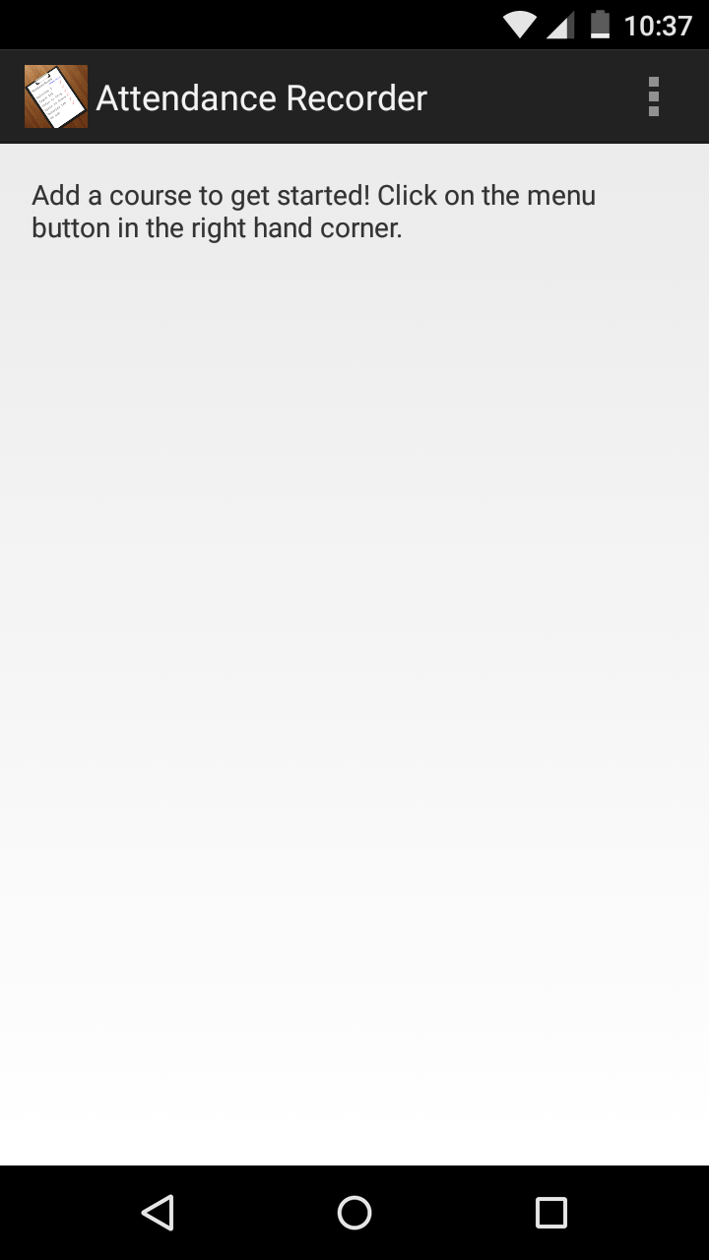

Currently no course is added. So it displays a message to add your subjects by clicking on this button… On tapping it…
FEATURE: Displayed a message.

Slide 5
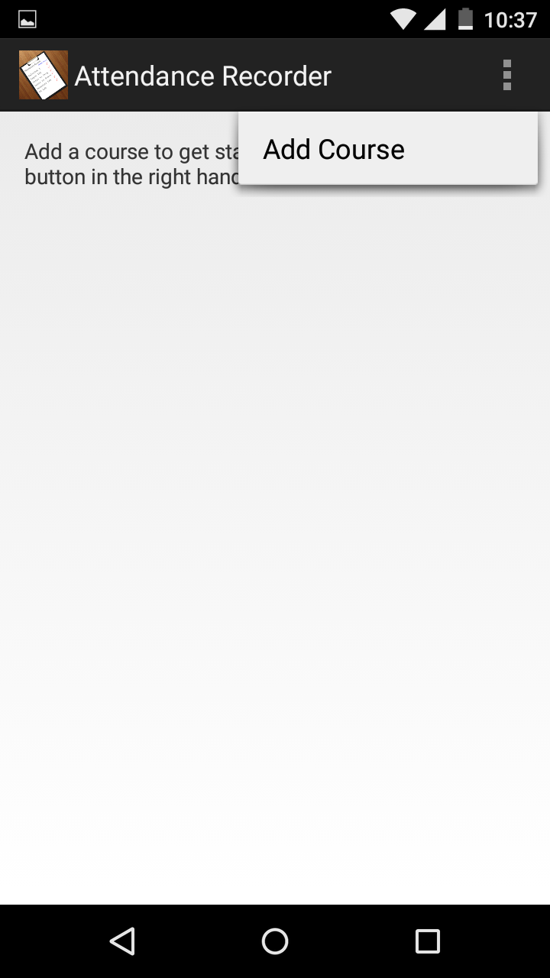
So you tap the “Add Course” option available to get the following screen…
FEATURE: A list view.

Slide 6
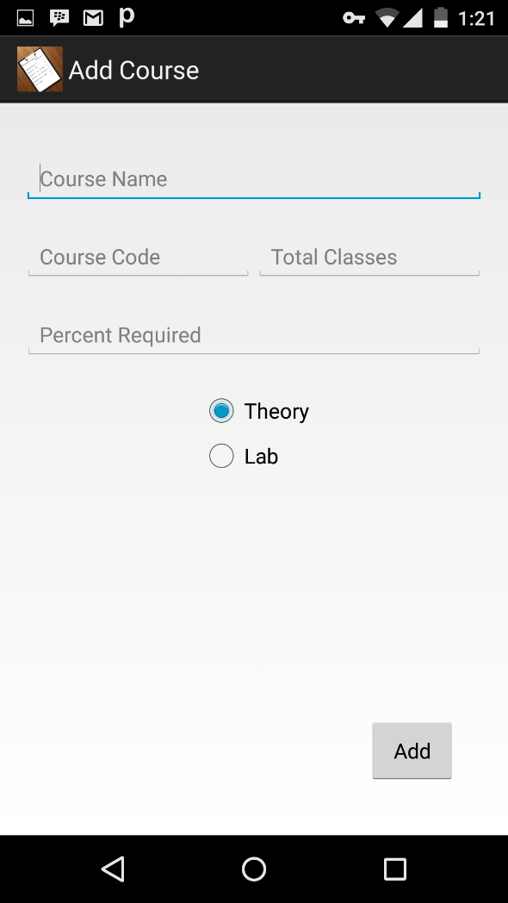
Here it asks for the basic informations about the subject.
FEATURES: Plain text view
Numeric text view
Radio group
Button

Slide 7
public void onClick(View paramView) { String str1 = AddCourse.this.courseName.getText().toString(); String str2 = AddCourse.this.courseCode.getText().toString(); String str3 = AddCourse.this.totalClasses.getText().toString(); String str4 = AddCourse.this.percentRequired.getText().toString(); int i = AddCourse.this.radioButtonGroup.getCheckedRadioButtonId(); if ((str1.length() == 0) || (str2.length() == 0) || (str3.length() == 0) || (str4.length() == 0)) { Toast.makeText(AddCourse.this, "Please fill all fields!", 0).show(); return; } if (Integer.parseInt(str4) > 100) { Toast.makeText(AddCourse.this, "Required % cannot be greater than 100!", 0).show(); return; } AddCourse.this.storeCourse(str1, str2, str3, str4, i); }

Slide 8
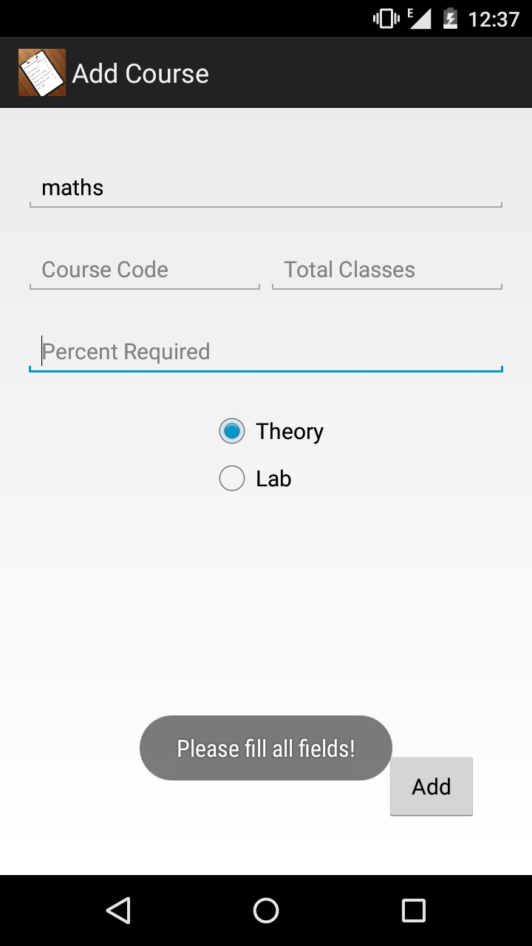
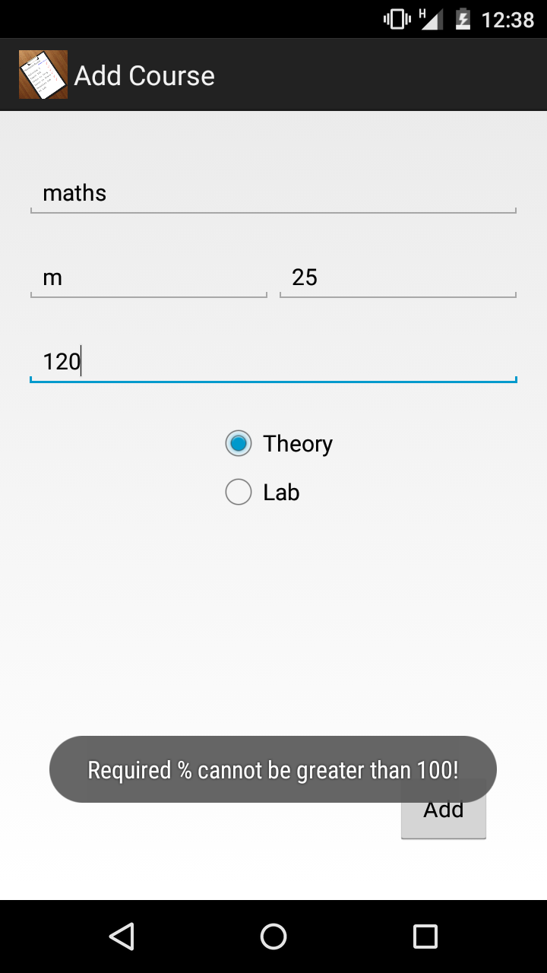

Slide 9
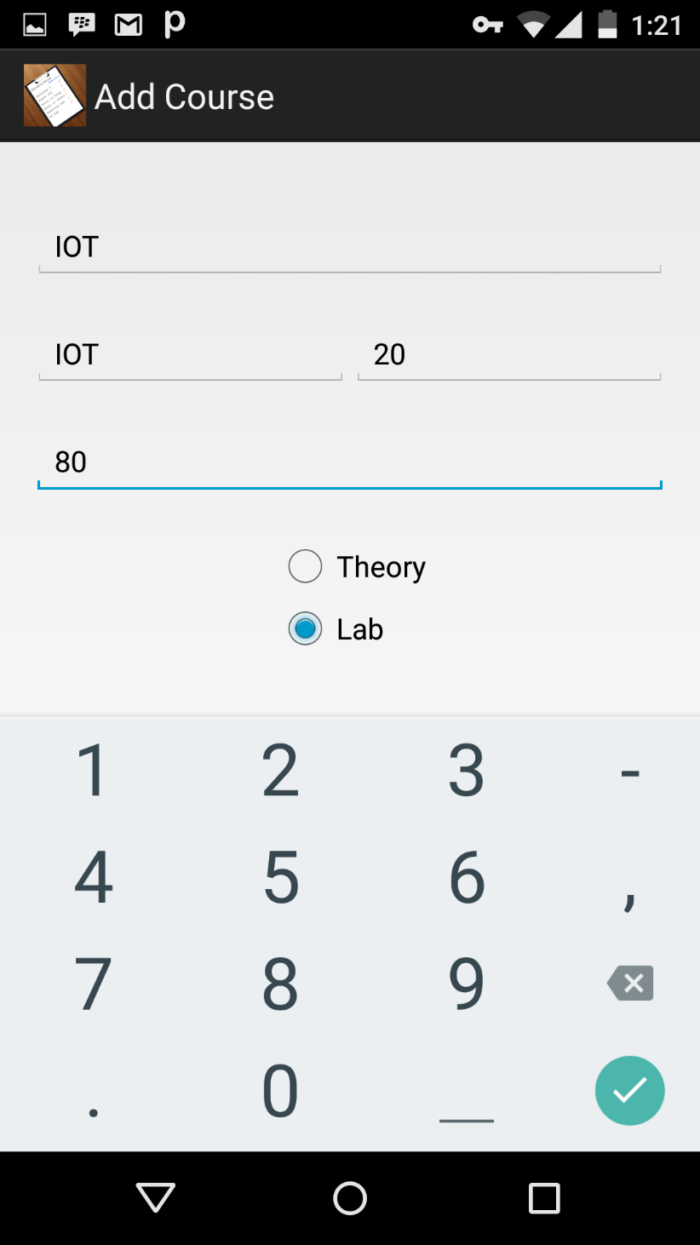
So we fill in the details asked. We also fill the % of attendance required in that subject. And then we click the add button.

Slide 10
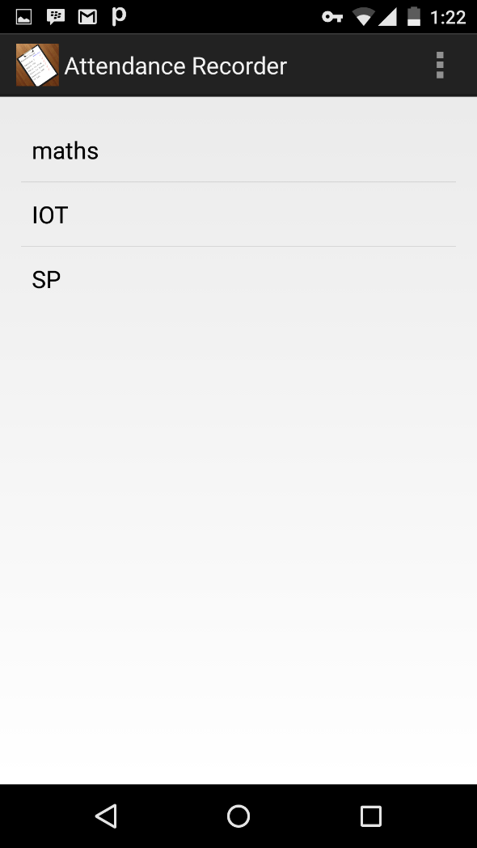
After adding few subjects this is what our screen will look like… Suppose we want to edit any information that we have provided, then we long press(press and hold) that particular subject. On long pressing a subject…
FEATURE: Long press Function

Slide 11
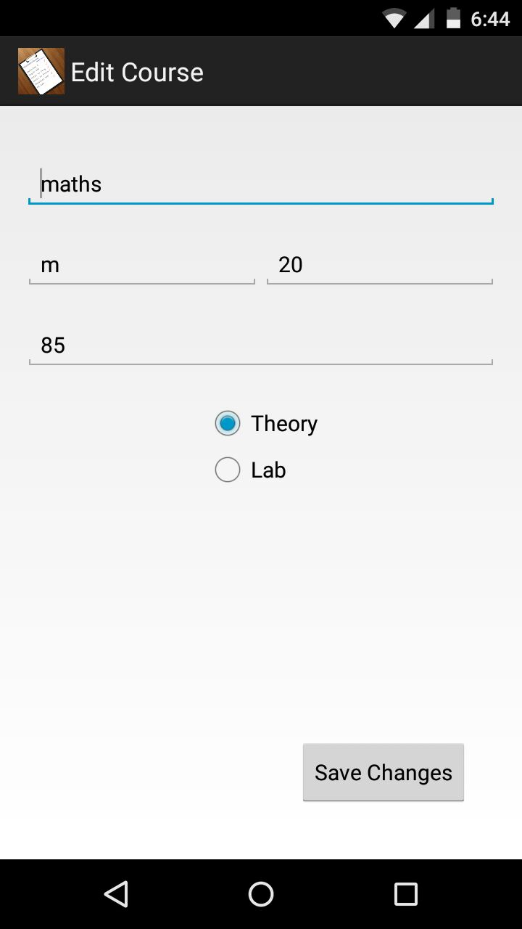
Now we can make the required changes and save it.

Slide 12
Now we click on any one of the subjects to move ahead.

Slide 13
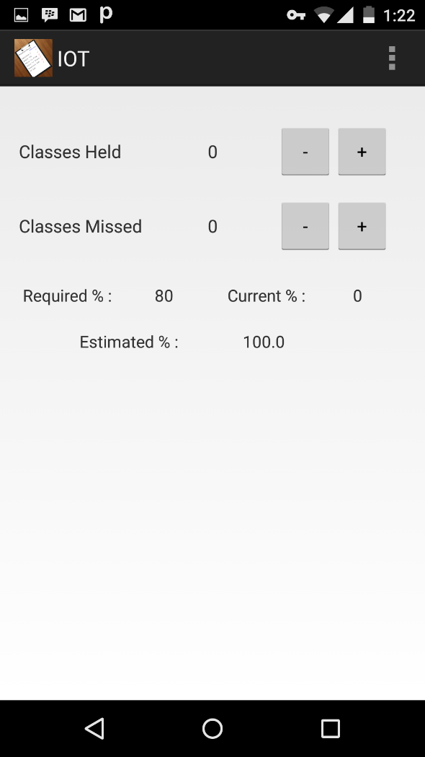

Classes Held : No. of classes totally conducted till date. Classes Missed: No. of classes bunked till date. We use these buttons to decrement or increment the classes

Slide 14


CASE 1: You attend a lecture So we just press the button once for classes held. CASE 2: You bunk a lecture So you press button for both classes held as well as missed.

Slide 15
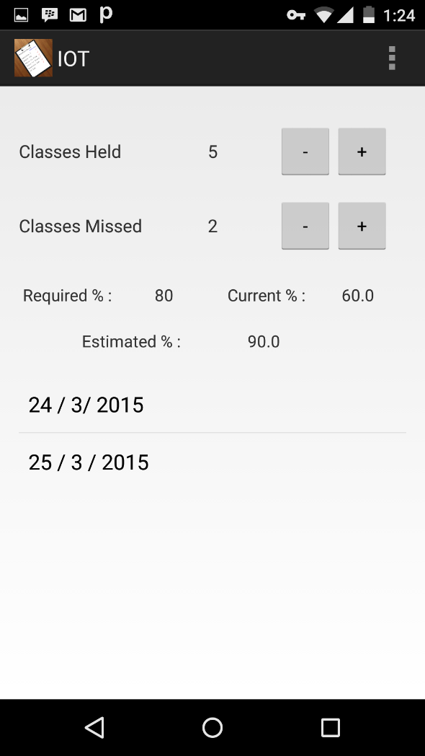
As soon as we adjust the classes, the percentages will be updated. Current %: Your current attendance as per classes missed. Estimated %: Your attendance at the end of semester if you do not miss any class further.

Slide 16
When you miss a class, the present day’s date is added automatically in case we need to tally later for our convenience. This date can be altered by clicking over it.

Slide 17
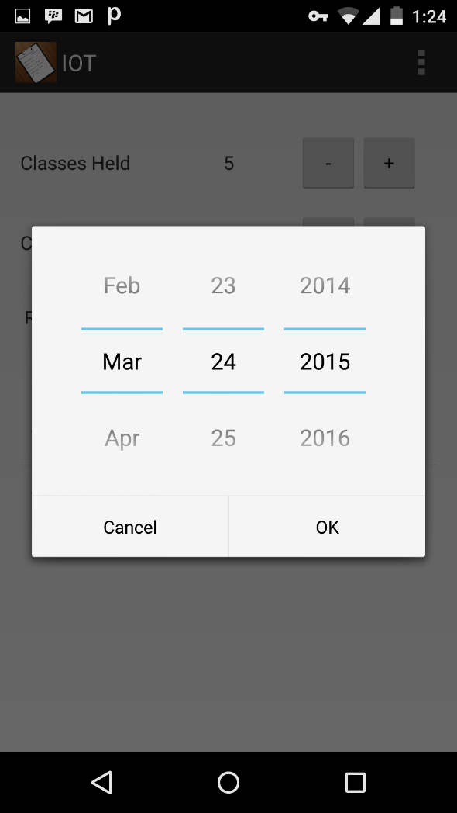
So we can alter the date and change it to the date we missed our lecture for remembrance.
FEATURE: DATE PICKER

Slide 18
import android.app.DatePickerDialog; import android.app.Dialog; import android.os.Bundle; import android.support.v4.app.DialogFragment; import java.util.Calendar; public class DatePickerFragment extends DialogFragment { public Dialog onCreateDialog(Bundle paramBundle) { Calendar localCalendar = Calendar.getInstance(); int i = localCalendar.get(1); int j = localCalendar.get(2); int k = localCalendar.get(5); return new DatePickerDialog(getActivity(), (CourseAttendance)getActivity(), i, j, k); } }

Slide 19
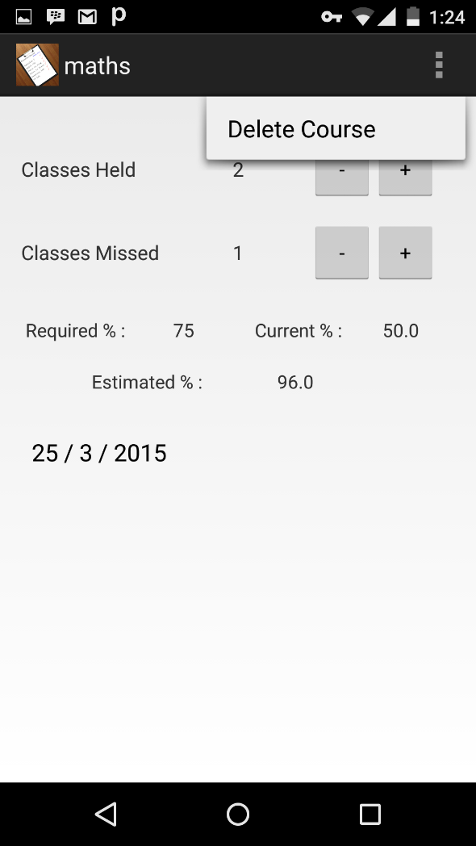

Now to delete a particular subject from your list, simply press the button while inside that course as shown and tap from the list view.

Slide 20
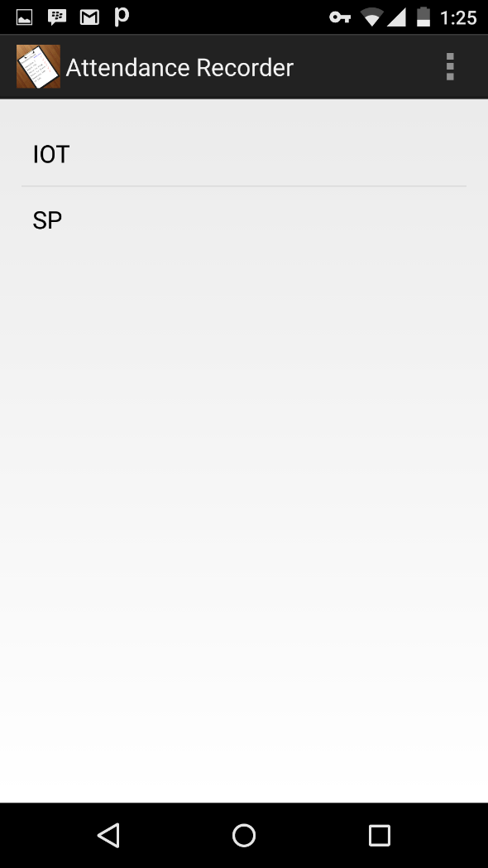
After deleting the course “Maths”, this is the screen we get…

Slide 21
So just use the app and
ENJOY IT.

Slide 22
NAVIGATION CODE:
Navigation code refers to the code that is used to move from one page of an app to another.
This navigation or change of page takes place on some event or activity.
Eg. OnClickEvent
So “Intent” code is used by us to link the different pages of our app to one another.

Slide 23
Code Examples:
1] MainActivity to CourseAttendance [ON CLICK]
public void onItemClick(AdapterView<?> paramAdapterView, View paramView, int paramInt, long paramLong)
{
Log.v("long clicked", "pos: " + paramInt);
Intent localIntent = new Intent(MainActivity.this, CourseAttendance.class);
.
.
.

Slide 24
2] MainActivity to EditCourse [ON LONG PRESS]
public boolean onItemLongClick(AdapterView<?> paramAdapterView, View paramView, int paramInt, long paramLong)
{
Log.v("long clicked", "pos: " + paramInt);
Intent localIntent = new Intent(MainActivity.this, EditCourse.class);
.
.
.

Slide 25
SALIENT FEATURES
IT IS VERY TO THE POINT APP. ALL UNNECESSARY PARTS ARE AVOIDED.
THE INTERFACE IS VERY USER FRIENDLY AND SIMPLE.
THE APP COMES WITH THE FEATURE TO PROVIDE DIFFERENT REQUIRED % FOR DIFFERENT SUBJECTS. HENCE MAKING IT MORE EFFICIENT.

Slide 26
WE HAVE TRIED TO USE DIFFERENT TOOLS TO MAKE OUR APP MORE INTERESTING SUCH AS:
DATE PICKER
RADIO GROUP
INSTANTANEOUS UPDATE

Slide 27
BIBLIOGRAPHY:
POONAM MA’AM
GOOGLE
YOUTUBE

Slide 28
OUR TEAM:
MONIL JAIN B042
MIHIR PATEL B058
KAJOL RATHOD B059
ANIKET KOTHARI B062

Slide 29
THANK YOU

